Slide 1

Songs Analysis With Power BI
PRESENTED BY
FASANYA TAIWO
BATCH MIP-DA-10

Slide 2
About
INTRODUCTION
YouTube is a global video-sharing platform where users can upload, view, share, and comment on videos. Analyzing YouTube’s data is important as it helps to uncover insights on viewership patterns, and content performance, which can help creators to tailor their content to meet audience preferences, enhancing viewer satisfaction and retention.
The aim of this analysis is to uncover trends, preferences, and patterns in a channel’s data to aid content creators and stakeholders in optimizing their YouTube song content.
Read More

Slide 3
About
DATA DESCRIPTION
Video_id: Unique identifier for each YouTube video.
Channel Title: Title of the YouTube channel publishing the song.
Title: Title of the YouTube song video.
Description: Description provided for the YouTube song video.
Tags: Tags associated with the YouTube song video.
Published At: Date and time when the YouTube song video was published.
View Count: Number of views received by the YouTube song video.
Like Count: Number of likes received by the YouTube song video.
Favorite Count: Number of times the YouTube song video has been marked as a favorite.
Comment Count: Number of comments posted on the YouTube song video.
Duration: Duration of the YouTube song video.
Definition: Video definition or quality (e.g., HD, SD).
Caption: Availability of captions for the YouTube song video.
Read More

Slide 4
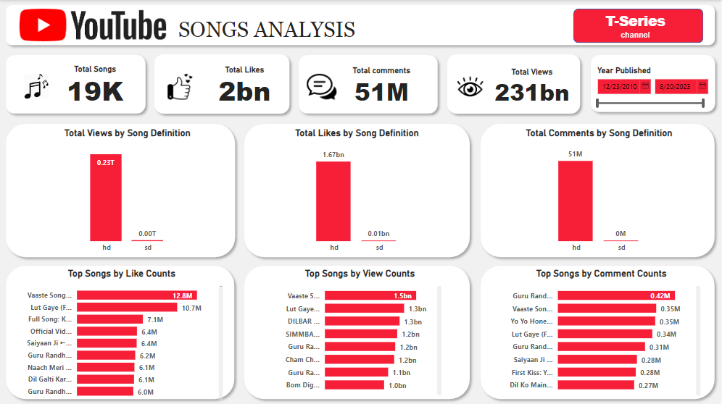

Slide 5
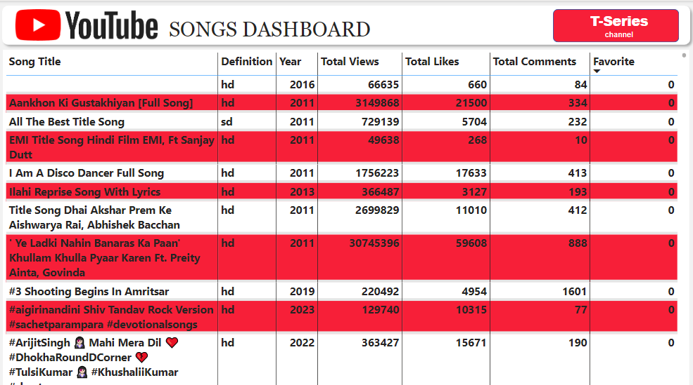

Slide 6
About
INSIGHTS
Song Definition: Songs in HD definition have far higher views, likes and comments than those in SD definition.
Viewers Engagement: The level of viewers engagement is low. The numbers of those who engage the posts by liking and commenting are far less than those who view .
Favorite Tags: The None of the songs were tagged to be their favorite by those who viewed or listened to them.
1
2
2
3
Read More

Slide 7
About
RECOMMENDATIONS
The content creators should focus more on HD definition contents as they attract more views than SD contents.
The content creators need to device strategies to get more of the people who view their content to engage them. This can be through constant reminders in the course of watching the videos or listening to the songs.
1
2
3
Read More

